Slide 1

Notes:
First class object

Slide 2
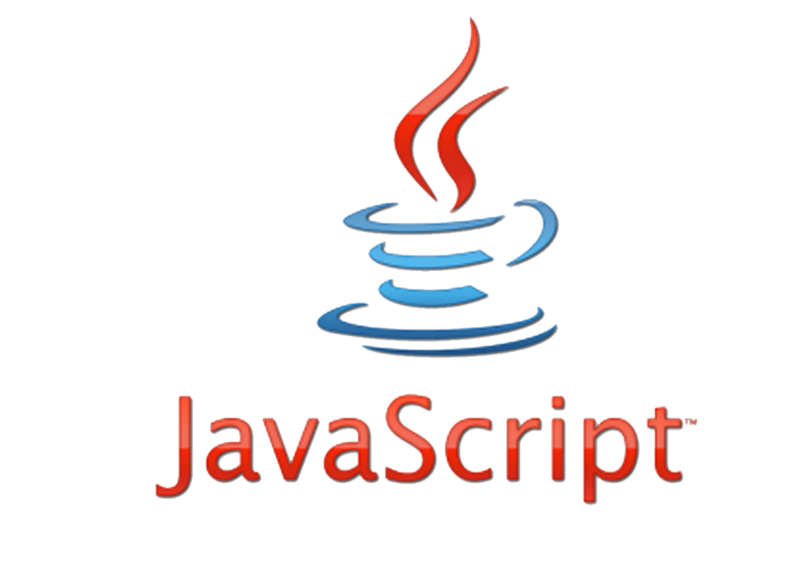
JavaScript Is Nothing to do with JAVA
It is used to make webpages interactive and provide online programs.
Notes:
What is HTML?
HTML is the standard markup language for creating Web pages.
HTML stands for Hyper Text Markup Language
HTML describes the structure of Web pages using markup
HTML elements are the building blocks of HTML pages
HTML elements are represented by tags
HTML tags label pieces of content such as "heading", "paragraph", "table", and so on
Browsers do not display the HTML tags, but use them to render the content of the page

Slide 3
JavaScript
JavaScript is a scripting language.
Designed to add interactivity to HTML pages and create dynamic web sites.
i.e. Change contents of document, provide forms and controls, animation, control web browser window, etc.
JavaScript statements embedded in an HTML page can recognize and respond to User Events.
JavaScript is very simple and flexible.
Powerful, beautiful and full-fledged dynamic Programming Language

Slide 4
Languages Types
Markup Language
Programming Language
Scripting Language
Notes:
Scripting Language
- Interpreted command by command, and remain in their original form.
Programming Language
Compiled, converted permanently into binary executable files (i.e., zeros and ones) before they are run.
Markup Language
A text-formatting language designed to transform raw text into structured documents, by inserting procedural and descriptive markup into the raw text.

Slide 5
Scripting vs. Programming vs. Markup Language
Scripting Language
Interpreted command by command and remain in their original form.
Programming Language
Compiled, converted permanently into binary executable files (i.e., zeros and ones) before they are run.
Markup Language
A text-formatting language designed to transform raw text into structured documents, by inserting procedural and descriptive markup into the raw text.

Slide 6

Founder Brendan Eich
Late 1995

Slide 7



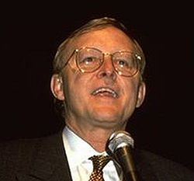

1993 introduce images
1995 Font Element And Text Decoration
Brendan Eich
James H. Clark
Marc Andreessen
Notes:
Mozaic first popular browser (images) 1993
Netscape 1995 (Mozaic Developers Head Hunting) font element and text formatting
1995 bring Berdan Eich(CTO of firefox) to developer Events

Slide 8




2 weeks
LiveScript
Notes:
Scheme 1975 => function as a First class object(Passed and returned from functions and can be property on class)
Self 1989 by Xerox => First Prototypal Programing Language (No Classes it only objects that can inherits from object).
1992 sun bye small talk (oop language) & self and create java
1995 sun decided to kill one of the types of programing => kill Prototypal (self)
Briden Eich create LiveScript from the best of the three languages

Slide 9




1995
1996
JavaScript
JScript
1997
Script

Slide 10

V1.0
V1.3 ECMAScript 1 & 2
V1.8.5 ECMAScript 5
V1.5 ECMAScript 3
V1.6 ECMAScript for XML
ECMAScript 6

Slide 11

What we can do with
JavaScript
Infinite Scrolling
Parallax
Games
IOT
Web Application

Slide 12
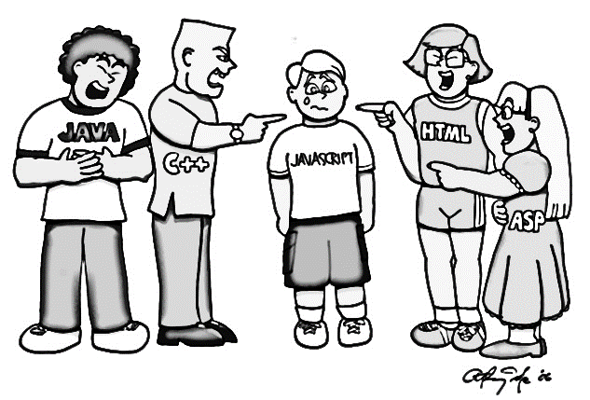
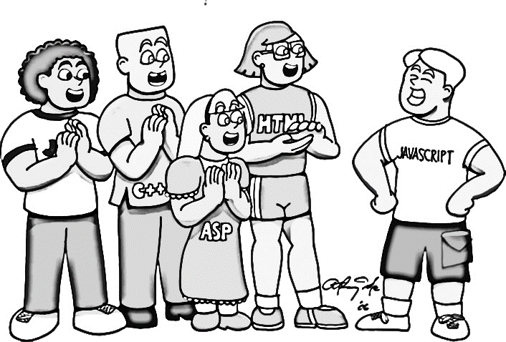
After
Before

Slide 13
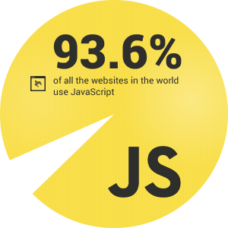

Slide 14
JavaScript Characteristics
Case sensitive.
Object-based.
Event-Driven.
Browser-Dependent.
Interpreted language.
Dynamic.

Slide 15
Where we can write
JavaScript Code
HTML File
Script Tag
External File
Filename.js + Script tag
Event Handling
Head or Body

Slide 16
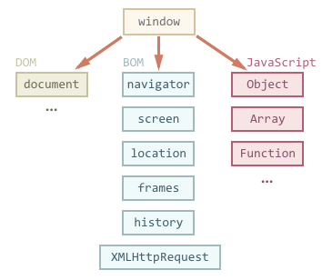
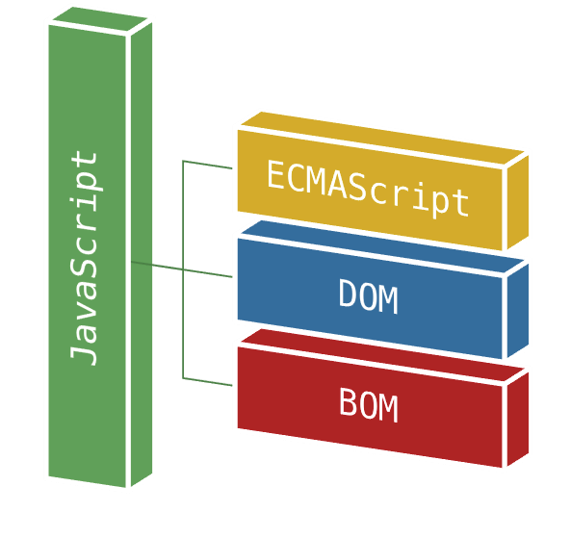

Slide 17
Variable
Data Type
Name
Value
Address
Variables

Slide 18
Variables Names
First char a-z or A-Z or _
Other char a-z or A-Z or _ or 0-9
No whitespaces
Avoid reserved words
Case-sensitive

Slide 19
Number
String
Null
Boolean
Undefined
Objects
Data Types
Notes:
Value
Example
Number
Any numeric value (e.g., 3, 5.3, or 45e8) double 8 byte => .1 + .2 = .3000000000000004 take care
String every char 2 byte
Any string of alphanumeric characters
(e.g., "Hello, World!", "555-1212" or "KA12V2B334")
Boolean
True or False values only
null
A special keyword for the null value
undefined
A special keyword for the unassigned value

Slide 20
var x = 5
Declaration
OPTIONAL
Variable
NAME
VALUE
Notes:
If you redeclare a JavaScript variable, it will not lose its original value.
var x=5; var x;
After the execution of the statements above, the variable x will still have the value of 5. The value of x is not reset (or cleared) when you redeclare it.

Slide 21
Comments
// single line of text
/* multiline
of text */

Slide 22
Operator | Description | Example | Result
+ | Addition | x=y+2 | x=7
- | Subtraction | x=y-2 | x=3
* | Multiplication | x=y*2 | x=10
/ | Division | x=y/2 | x=2.5
% | Modulus (division remainder) | x=y%2 | x=1
++ | Increment | x=++y | x=6
-- | Decrement | x=--y | x=4
Arithmetic Operators

Slide 23
Operator | Example | Description
= | x = y Sets x to the value of y | Assigns the value of the right operand to the left operand
+= | x += y i.e. x = x + y (15) | Adds together the operands and assigns the result to the left operand.
–= | x –= y i.e. x = x – y (5) | Subtracts the right operand from the left operand and assigns the result to the left operand.
*= | x *= y i.e. x = x * y (50) | Multiplies together the operands and assigns the result to the left operand.
/= | x /= y i.e. x = x / y (2) | Divides the left operand by the right operand and assigns the result to the left operand.
%= | x %= y i.e. x = x % y (0) | Divides the left operand by the right operand and assigns the result to the left operand.
Assignment Operators

Slide 24
Operator | Description | Example
== | is equal to | x==8 is false
=== !== | is exactly equal to (value and type) | x===5 is true x==="5" is false
!= | is not equal | x!=8 is true
> | is greater than | x>8 is false
< | is less than | x<8 is true
>= | is greater than or equal to | x>=8 is false
<= | is less than or equal to | x<=8 is true
Comparison Operators
Notes:
== if different types evaluate to Number() if one of them is null return false

Slide 25
Operator | Definition
&& | Logical "AND" – returns true when both operands are true; otherwise it returns false (Gard Operator)
|| | Logical "OR" – returns true if either operand is true. It only returns false when both operands are false (Default Operator)
! | Logical "NOT"—returns true if the operand is false and false if the operand is true. This is a unary operator and precedes the operand
Logical Operators
Notes:
&& return one of the parameters not bool

Slide 26
Ternary Operator
(condition) ? true : false
Notes:
temp=120
newvar=(temp>100) ? ”red” : “blue” // the value of newvar will be “red”
temp=20
newvar=(temp>100) ? ”red” : “blue” // the value of newvar will be “blue”
Comma operator
var k=0, i, j=0;

Slide 27
typeof Operator
typeof Operator
A unary operator returns a string that
represents the data type.
The return values of using typeof can be one of the following:
"number", "string", "boolean", "undefined","object", or "function".
Example:
var myName = “javascript”;
typeof myName; //string

Slide 28
JavaScript Expression
An expression is a part of a statement that is evaluated as a value.
Main types of expressions:
Left-hand-side “Assignment”
a = 25; ➔ assign RHS to variable of LHS
Arithmetic
10 + 12; ➔evaluates to sum of 10 and 12
String
“Hello” + ” All !!”; ➔ evaluates to new string
Logical
25<27 ➔ evaluates to the Boolean value

Slide 29
Coercion
Coercion is forcing conversion from one data type to another when expression is executed giving a result without causing any error.
Sometimes gives surprising results from human perspective
JavaScript engine coerce
Number to string 1+”2”➔”12”
Boolean to number 3<2<1➔true
Both undefined and null coerce to false

Slide 30
Operator Precedence
The operators that you have learned are evaluated in the following order (from highest precedence to lowest):
1. Parentheses(())
2. Multiply/divide/modulus (*, /, %)
3. Addition/Subtraction (+, -)
4. Relational (<, <=, >=, >)
5. Equality (==, !=)
6. Logical and (&&)
7. Logical or (||)
8. Conditional (?:)
9. Assignment operators (=, +=, -=, *=, /=, %=)
Notes:
Example:
5 + 3 * 2 = 11 ➔ 3*2=6 , then 6+5 = 11.
BUT
(5 + 3) * 2 = 16 ➔ 5+3 = 8 , then 8*2 = 16.

Slide 31
if
switch
for
while
do-while
for in
Control Statements
Conditional Statements
Loop Statements
Notes:
if (condition)
{ statements if condition is true; }
else { statements if condition is false; }
switch (expression)
{ case label1:statements
break
case label2:statements
break
default : }

Slide 32
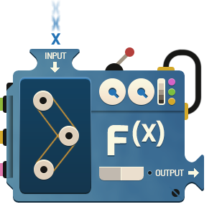
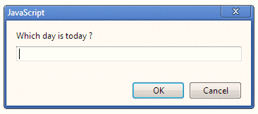
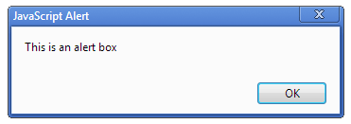
Input
Output

Slide 33
Console
console.log(any data)

Slide 34
Communicating with the User
Four ways of communication:
one that displays a text message in a pop-up window
one that asks for information in a pop-up window
one that asks a question in a pop-up window
and one that displays a text message in the browser window.

Slide 35
Dialogues and Alerts
There are 3 types of dialogues:
alert()➔ Show a message box with one button, has no return.
confirm() ➔ Show a message box with 2 buttons (OK and Cancel).
Returns true ➔ OK pressed.
Returns false ➔ Cancel pressed.
prompt() ➔ Show a message box with 2 buttons (OK and Cancel) and a textbox
Returns the text in textbox ➔OK pressed
Returns null ➔ Cancel pressed

Slide 36
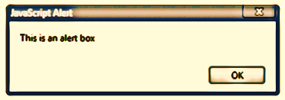
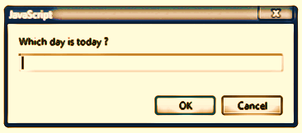
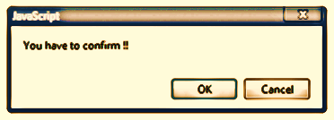
Popup Boxes

Slide 37
Outputting text with JavaScript
(on the current window)
You can write out plain text or you can mix HTML tags in with the text being written using document.write()
to return text to the browser screen.
document.write(“ ”)
Example: document.write(”Hello There!“)

Slide 38
JavaScript Functions
A function is an organized block of reusable code (a set of statements) that handles and performs actions generated by user events.
Functions categorized into
built-in functions improve your program's efficiency and readability.
user defined functions , created by developer to make your programs scalable.
Function executes when it is called.
from another function
from a user event, called by an event or
from a separate <script> block.

Slide 39
Global Properties & functions
Function | Description
eval() | Evaluates a string and executes it as if it was script code
isFinite() | Determines whether a value is a finite, legal number
isNaN() | Determines whether a value is an illegal number
Number() | Converts an object's value to a number
parseFloat() | Parses a string and returns a floating-point number
parseInt() | Parses a string and returns an integer
String() | Converts an object's value to a string

Slide 40
Object Categories
Built-in objects
Object
Math
String
Boolean
Array
Date
Number
Host Objects
BOM
DOM
Author Objects
All other objects

Slide 41
JavaScript Objects fall into 4 categories
1. Custom Objects (User-defined)
Objects that you, as a JavaScript developer, create and use.
2. Built – in Objects (Native)
Objects that are provided with JavaScript to make your life as a JavaScript developer easier.
3. BOM Objects “Browser Object Model” (Host)
It is a collection of objects that are accessible through the global objects window. The browser objects deal with the characteristic and properties of the web browser.
4. DOM Objects “Document Object Model”
Objects provide the foundation for creating dynamic web pages. The DOM provides the ability for a JavaScript script to access, manipulate, and extend the content of a web page dynamically.

Slide 42


String
Array
Date
Math
RegExp
Error
Function
Boolean
Number
Object

Slide 43
Object
Constructor
Properties
Properties
Functions
Functions
Notes:
http://kangax.github.io/compat-table/es5/
https://caniuse.com/
Very Important namespaces and writing functions (008) Modules
Object is hash table key string and value any thing
Any hash table can update and get or delete

Slide 44
Strings are useful for holding data that can be represented in text form.
Wrapper
String
Notes:
Ascii (127) and extended asci (256)
UTF 8 (1 to 4 bytes) vs UTF 16 (2 to 4 bytes) vs UTF 32 (4 bytes)
UCS 2 (2 bytes)
Encoding and decoding
\u

Slide 45
String Object
Enables us to work with and manipulate strings of text.
String Objects have:
Property
length : gives the length of the String.
Methods that fall into three categories:
Manipulate the contents of the String
Manipulate the appearance of the String
To create a String Object
var str = new String(‘hello’);

Slide 46
String Object Methods
Method Name | Description
charAt(n ) | Return the character at a given position
indexOf( substr,[start]) | Searches for first occurrence for a substring.
lastIndexOf( substr,[start]) | Searches for last occurrence for a substring.
toUpperCase( ) | Returns with all characters converted to uppercase.
trim | removes whitespace from both ends of a string
substring(from, to) | method returns the part of the string between the start and end indexes, or to the end of the string.
slice(start , end) | Extracts a substring of a string. What’s the difference then ?
split(delimiter, limit) | Return array of strings, from splitting string into substrings at the boundaries specified by delimiter, constrained by limit number of elements.

Slide 47
Regular expression object for matching text with a pattern.
RegExp

Slide 48
RegExp Object
Regular expressions provide a powerful way to search and manipulate text.
A Regular Expression is a way of representing a pattern you are looking for in a string.
A Regular Expression lets you build patterns using a set of special characters. Depending on whether there's a match, appropriate action can be taken.
People often use regular expressions for validation purposes.
In the validation process; you don't know what exact values the user will enter, but you do know the format they need to use.

Slide 49
RegExp Object
➔RegExp Method test()
returns a boolean (true when there's a match, false otherwise)
Example:
/j.*t/.test("Javascript")
false (case sensitive)
➔How to write regExp (self study)

Slide 50
Wrapper
Number object is a wrapper object allowing you to work with numerical values.
Number
Notes:
Parseint() , Number()

Slide 51
Number Object
To create a Number Object
→ var n = new Number(101);
OR
→ n = new Number(); // if not assigned a value initially n =0
→ n=10; // value changed to n=10
Number has a set of Constant values & object methods.

Slide 52
Wrapper
Boolean object is an object wrapper for a boolean value.
Boolean

Slide 53
Boolean Object
The Boolean object is used to convert a non-Boolean value to a Boolean value (true or false).
■ Everything in the language is either “truthy” or “falsy”
■ The rules for truthiness:
0 , ”” , NaN , null , and undefined → falsy
Everything else → truthy
■ You can convert any value to it’s boolean equivalent by applying “!!” preceding the value
■ Example:
!!”” ➔ false
!!123 ➔true
■ To create Boolean Object
var b = new Boolean(); → false // typeof is Object
B = false → false // typeof “boolean”

Slide 54
Boolean Object
➔All the following lines of code create Boolean objects withan initial value of false:
var myBoolean=new Boolean()
var myBoolean=new Boolean(0)
var myBoolean=new Boolean(null)
var myBoolean=new Boolean(undefined)
var myBoolean=new Boolean("")
var myBoolean=new Boolean(false)
var myBoolean=new Boolean(NaN)

Slide 55
Boolean Object
➔And all the following lines of code create Boolean objects with an initial value of true:
var myBoolean=new Boolean(true)
var myBoolean=new Boolean(1)
var myBoolean=new Boolean("false“)
var myBoolean=new Boolean(“anyThing")

Slide 56
Math is a built-in object that has properties and methods for mathematical constants and functions.
Math

Slide 57
Math Object
Allows you to perform common mathematical tasks.
The Math object is a static object.
Math is a little different from other built-in objects because it cannot be used as a constructor to create objects.
Its just a collection of functions and constants

Slide 58
Math Object
Constant Properties:
Constants | value
Math.PI | 3.141592653589793
Math.E | 2.718281828459045
Math.LN2 | 0.6931471805599453

Slide 59
Math Object
Methods
Methods
Math.abs() | Returns the absolute unsigned value
Math.ceil() | Return rounded number up to nearest interger
Math.cos() | Returns cosine of number
Math.floor() | Returns number down to nearest integer
Math.pow() | Returns the number raised to a power
Math.random() | Returns a number between 0 and 1.0
Math.sqrt() | Returns square root of number
Math.round() | Returns number rounded to closest integer

Slide 60
Date instance that represents a single moment in time.
Date

Slide 61
Date Object
Object to manipulate date and time based on the local machine time.
Examples:
var d=new Date() //returns date of local machine now
Note: The argument month Index is 0-based. This means that January = 0 and December = 11.
var d = new Date(2008, 1, 1); //31/1/2008
var weekday = d.getDay( ); //0 ➔ Sunday

Slide 62
Date Types
Type | Example
ISO Date | "2015-03-25" (The International Standard)
Short Date | "03/25/2015"
Long Date | "Mar 25 2015" or "25 Mar 2015"
Full Date | "Wednesday March 25 2015"

Slide 63
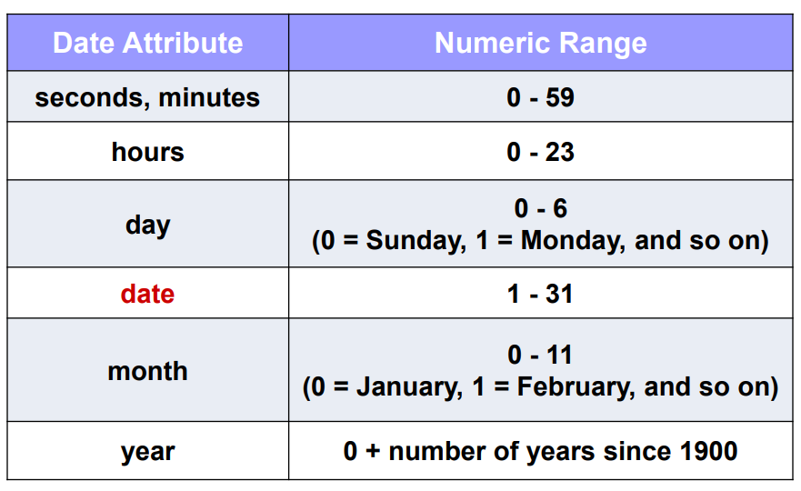
Date Object Number Conventions

Slide 64
Array object is a global object that is used in the construction of arrays.
Array

Slide 65
Array Object
Array is a special type of object
It has length property:
gives the length of the array It is one more than the highest index in the array
Declaring an array
var myarr=[]; //declaring an array literal
var myarr=[1 , 2 , ‘three’,’four’,false];
var myarr= new Array() //using array constructor.
var myarr=new Array(2) //an array with 2 undefined elements
var myarr=new Array(1,2,’r’,true); //an array with 4 elements

Slide 66
Array Methods
Method | Description
concat() | Concatenates elements from one array to another array.
join() | Joins the elements of an array by a separator to form a string.
pop() | Removes and returns the last element of an array.
push() | Adds elements to the end of an array.
reverse() | Reverses the order of the elements in an array.
shift() | Removes and returns the first element of an array.
slice([begin[, end]]) | Creates a new array from elements of an existing array.
sort() | Sorts an array alphabetically or numerically.
Splice(start[, deleteCount[, item1[, item2[, ...]]]]) | Removes and/or replaces elements of an array.
toString() | Returns a string representation of the array.
unshift() | Adds elements to the beginning of an array.

Slide 67
Every JavaScript function is actually a Function object.
Function

Slide 68
User-defined functions
Function blocks begin with the keyword function followed by the function name and () then {} its building block declaration.
Syntax:
function functionName (argument1, argument2, ...)
{
//statement(s) here
//return statement;
}
return can be used anywhere in the function to stop the function’s work. Its better placed at the end.

Slide 69
Defining function
function myFunction(x,l)
{
var y = x+l;
return y;
}
Functions
Calling function
var z = myFunction(5,6)
Notes:
Function Types
Function Statement
Function Expresions
Arguments Array & this argements
This is the caller else if use (apply or call)

Slide 70
User-defined functions
Function can be called before its declaration block.
Functions are not required to return a value
Functions will return undefined implicitly if it is to set explicitly
When calling function it is not obligatory to specify all its arguments
The function has access to all of its passed parameters via arguments collection
We can specify default value using || operator or ES6 default function parameters

Slide 71
Variable
Scope
Life Time
Notes:
Block Scope vs Function Scope
JavaScript is Function Scope

Slide 72
JavaScript Variables Lifetime
Global Scope
A variable declared outside a function and is accessible in any part of your program
Local Scope
A variable inside a function and stops existing when the function ends.

Slide 73
Understanding Scopes
Global
var1
var2
function
var3
var4
function
var5
var6

Slide 74
Variable Scope
It is where var is available in code
All properties and methods are in the public global scope
They are properties of the global object “window”
There was no Block Scope before ES6, only function scope
Variables declared
Inside a function are local variable
outside any function are global variable
i.e. available to any other code in the current document

Slide 75
Variable
Hoisting
Notes:
Function Hoisting
Best practice
Declare all variables at top
Declare functions before use

Slide 76
Hoisting
Hoisting takes place before code execution
Variables
Any variable declared with var is hoisted up to the top of its scope
Hoisted variables are of undefined value.
We can refer to a variable declared later without getting any exception or error
Functions
Function statements are hoisted too.
Functions are available even before its declaration

Slide 77
What is the output of the execution?
function b() {
var myvar = 1;
console.log(myvar);
}
console.log(x);
a();
b();
function a() {
var myvar = 2;
console.log(myvar);
}
var x = 5;
Notes:
Undefined
2
1

Slide 78
What is the output of the execution?
function f1(x,y)
{
if(x>3)
{
var z=3;
}
else
{
var zz=3;
}
console.log(z,zz)
zzz=300;
}
f1(1,3);
alert(zzz);
Notes:
First ➔ undefined, 3
Second alert ➔ 300

Slide 79
What is the output of the execution?
function f1(x,y)
{
if(x>3)
{
var z=3;
}
else
{
var zz=3;
}
console.log(z,zz)
zzz=300;
}
//f1(1,3);
alert(zzz);
Notes:
Error in page since zzz is not defined.

Slide 80
What is the output of the execution?
function b() {
var myvar;
console.log(myvar);
}
function a() {
var myvar = 2;
console.log(myvar);
b();
}
var myvar = 1;
console.log(myvar);
a();
console.log(myvar);
Notes:
1
2
Undefined
1

Slide 81
What is the output of the execution?
function b() {
//var myvar;
console.log(myvar);
}
function a() {
var myvar = 2;
console.log(myvar);
b();
}
var myvar = 1;
console.log(myvar);
a();
console.log(myvar);
Notes:
1
2
1
1

Slide 82
What is the output of the execution?
function square(num)
{
total = num * num;
return total;
}
var total = 50;
var number = square(20);
alert(total);
Notes:
Alert ➔ 400
Variable inside function is in a global scope

Slide 83
Functions (Cont’d)
Anonymous functions is a function without name
Example:
var f=function(a,b){return a+b}
To call it,
var x=f(1,2) ➔ x=3;
Self-invoked function: are anonymous functions invoked just after it declaration.
Anonymous functions are used as:
Callback functions
Self-invoked functions
To self-invoke an anonymous function add () to the end of its definition
Example:
var x=(function(a,b){return a+b})(1,2) ➔ x=3

Slide 84
Functions (Cont’d)
Callback functions:
Functions sent to other functions.
Example:
function invoke_and_add(a, b)
{
return a() + b();
}
function one() {return 1;}
function two() {return 2;}
invoke_and_add(one, two);
invoke_and_add(function(){return 1;}, function(){return 2;})

Slide 85
Function expression hoisting
Function expressions in JavaScript are not hoisted, unlike function declarations. You can't use function expressions before you create them
console.log(s);
s();
var s = function(){
console.log("func")
}
s();

Slide 86
a global object, where all global variables are properties of it
all methods defined are also properties of it, can be called by name or through window object
Window

Slide 87
Host Objects
Since the browser is the native host environment for client-side JavaScript programs, there are collections of objects dealing with it.
The BOM (Browser Object Model)
represents objects dealing with what’s outside loaded page, through the global object
window
The DOM (Document Object Model)
Represents loaded page through object
window.document or document

Slide 88

Document object is the root node of the HTML document and the "owner" of all other nodes
Document
Notes:
document.querySelectorAll()
Attributes vs properties (011)

Slide 89
DOM
document
elements
attributes
events
style

Slide 90
HTML DOM Nodes
The document itself is a document node
All HTML elements are element nodes
All HTML attributes are attribute nodes
Text inside HTML elements are text nodes
Comments are comment nodes

Slide 91
DOM
The Document Object Model represents the document as a node tree (parent, child, and sibling).
Types of Nodes:
Element Nodes
Text Nodes
Attribute Nodes
Comment Nodes

Slide 92
Element object represents an HTML element.
Element objects can have child nodes of type element, text, or comment nodes.
Elements
Notes:
FirstChild & LastChild
NextSibling & PreviousSibling
ParentNode
ChildNodes

Slide 93
Attr object represents an HTML attribute.
Attributes
Notes:
// Create an object. Store a reference to it in a variable.
var book = new Object( );
// Set a property in the object.
book.title = "JavaScript: The Definitive Guide"
// Set some more properties. Note the nested objects.
book.chapter1 = new Object( );
book.chapter1.title = "Introduction to JavaScript";
book.chapter1.pages = 19;
delete book.chapter2;
var circle = { x:0, y:0, radius:2 }
// Examples For Declaring Objects as literals.
Var homer =
{
name: "Homer Simpson",
age: 34,
married: true,
occupation: "plant operator",
email: "homer@simpsons.com"
};

Slide 94
Events allow JavaScript to register different event handlers on elements in an HTML document.
Events
Notes:
Node.addEventListner(event,function,false) => isCapturing
Capturing And Bubbling
Canceling Bubbling (011)
Prevent Default Action (Submit , Reset , Link)

Slide 95
Style object represents an individual style statement.
Style

Slide 96
HTML Example
<html>
<head><title>Sample Document</title></head>
<body>
<h1>An HTML Document</h1>
<p>This is a <i>simple</i>document</p>
</body>
</html>

Slide 97
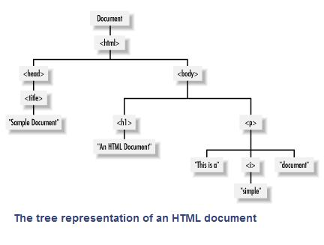

Slide 98
Accessing DOM Nodes
All nodes have
nodeType,
nodeName (mostly are tag names),
nodeValue (for text nodes; the value is the actual text)
window.document: access to the current document.
documentElement: the root node <html>
childNodes:
In order to tell if a node has any child Nodes you use hasChildNodes(): ➔true/false
childNodes[]➔ array to access child nodes of any element, has all array properties.
a property of Nodes
children:
a property of Elements, returns array of all child elements of an element.
parentNode/parentElement(DOM4):
Provided to child to access its parent

Slide 99
Accessing DOM Nodes
window.document (Cont’d):
nextSibling/nextElementSibling, previousSibling/previousElementSibling
firstChild/firstElementChild, lastChild/lastElementChild
attributes
In order to tell if a node has any attributes you use hasAttributes() ➔ true/false also hasAttribute(“attr”)
attributes[]➔ array to access all attribute nodes of any element.
getAttribute(attrname) ➔ to get the value of a certain attribute.
setAttribute(attrname,value) ➔ to set value of a certain attribute.
Each attribute node has nodeName and nodeValue

Slide 100
A Shortcut to DOM elements
document.getElementById(id) returns an object representing element or null if not found
document.getElementsByTagName(tag) returns a collection of objects with the specified tag name or [] an empty array if not found
document.getElementsByName(name) returns a collection of objects with the specified name attribute or [] an empty array if not found
document.getElementsByClassName(name) returns a collection of objects with the specified class attribute or [] an empty array if not found

Slide 101
Modifying Style
Most of the visual element nodes have a style property, which in turn has a property mapped to each CSS property.
Example:
var my = document.getElementById(’mydiv');
my.style.border = "1px solid red";
CSS properties have dashes but in JavaScript map their names to properties by skipping the dash and uppercase the next letter.
padding-top, paddingTop, margin-left, marginLeft…..

Slide 102
Modifying Style (Cont’d)
You can change the css class using the className property or setAttribute() function.
Example:
var m=document.getElementById(‘mydiv’);
m.className=“errorclass”;
OR
m.setAttribute(‘class’,’errorclass’);

Slide 103
Creating New Nodes
Create nodes by createElement() and createTextNode().
Once you have the new nodes, you add them to the DOM tree with appendChild(). It must be called by the parent object to whose
children the node is added.
Example
var myp = document.createElement('p');
myp.innerHTML = 'yet another';
myp.style.border = '2px dotted blue’
document.body.appendChild(myp); //here appended to end of body directly

Slide 104
Clone Existing Node
cloneNode()
The method accepts a boolean parameter (true = deep copy with all the children, false = shallow copy, only this node).
Get a reference to the element you want to clone:
var el = document.getElementsByTagName('p')[1];
Create a shallow clone of el and append it to the body:
document.body.appendChild(el.cloneNode(false))
Create a deep copy, the whole DOM subtree
document.body.appendChild(el.cloneNode(true))

Slide 105
insertBefore
insertBefore is the same as appendChild(), but accepts an extra parameter, specifying before which element to insert the new node. It must be called through the parent where the element will be added.
insertBefore(newnode, existingchild)
Example:
At the end of the body:
document.body.appendChild(document.createTextNode('boo!'));
Add it as the first child of the body:
document.body.insertBefore(document.createTextNode('boo!'), document.body.firstChild);

Slide 106
Removing/Replacing Nodes
removeChild().
Specify node to be removed, send it to removeChild
var removed = document.body.removeChild(myp);
The method returns the removed node if you want to use it later.
replaceChild()
Removes a node and puts another one in its place.
First specify node to remove and node to add, then send them to function
var replaced = document.body. replaceChild(newnode,oldnode)
It returns a reference to the node that is now out of the tree.

Slide 107
Events
HTML creates the visual image of controls, but they are mute.
JavaScript animates it all and makes the page interactive through events, like a button press, a mouse hover, a text changed, a link pressed……etc.
Every HTML element has several events attached to it. These events need event handlers.
Event handler is JavaScript code that is executed when an event is triggered

Slide 108
Events (Cont’d)
Events can be attached to JavaScript code through one of the following ways:
Inline HTML Attributes
Element Properties
DOM Event Listeners

Slide 109
Inline HTML Attributes
Using event handler attributes inside the HTML tags.
We can embed JS code inside it or a call to JS function.
The attributes start with ‘on’ then the event name
Examples: onclick, onmouseover……etc.
<html>
<head><title>Event</title></head>
<body>
<form>
<input type ="button" value = "Click here" onClick="alert(Hello!!')” >
</form>
</body>
</html>

Slide 110
Types of Events
Mouse events
mouseup, mousedown, click, dblclick, mouseover, mouseout, mousemove.
Keyboard events
keydown, keypress, keyup.
Loading/window events
load, unload, beforeunload, abort, error, resize, scroll, contextmenu
Form events
change, select, reset, submit.

Slide 111
Elements Properties
assign a function to the on-event property of a DOM node element.
Example:
<div id="my-div">click</div>
<script type="text/javascript">
var myelement = document.getElementById('my-div');
myelement.onclick = function()
{
alert('Div Clicked!');
}
</script>
You can attach only one function to the event.

Slide 112
DOM Event Listeners
assign a function to the on-event property of a DOM node element.
Example:
<div id="my-div">click</div>
<script type="text/javascript">
var myelement = document.getElementById('my-div');
myelement.onclick = function()
{
alert('Div Clicked!');
}
</script>
You can attach only one function to the event.

Slide 113
Always keep in mind that HTML is for content, JavaScript for behavior and CSS for formatting, and you should keep these three SEPARATE as much as possible.

Slide 114
Event Object
The event object is passed implicit to the event handling function as an argument

Slide 115
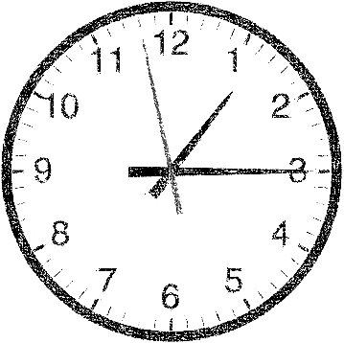
Timing Events
setTimeout()
clearTimeout()
setInterval()
clearInterval()

Slide 116
BOM
window
A collection of objects access the browser and the computer screen.
Accessible through the global objects window.
There's a window object for every popup, or browser tab.

Slide 117
BOM
window
navigator
location
history
document

Slide 118
window.open()/close()/print()
open() ➔ which open up new browser windows (popups).
It returns a reference to the window object of the newly created browser instance.
window.open(url, name, target, featurelist)
Features can be:
resizable: user is able to resize the new window
width, height
close()➔ closes the new window.
print() ➔to print page.

Slide 119
Navigator object contains information about the browser.
Navigator

Slide 120
navigator
The navigator is an object that has some information about the browser and its capabilities. It is used to identify the browser and provide different versions of the code.
One of its important properties is navigator.userAgent. It is a long string of browser identification.
Example: In Firefox
>>> window.navigator.userAgent
"Mozilla/5.0 (Macintosh; Intel Mac OS X 10.7; rv:16.0) Gecko/20100101 Firefox/16.0”

Slide 121
History object contains the URLs visited by the user (within a browser window).
History

Slide 122
history
It allows limited access to the previously-visited pages in the same browser session.
history.length ➔ the number of pages visited before this one.
history.forward() ➔ navigate forward through the user's session (Forward Button)
history.back() ➔ navigate backward through the user’s session (Backward Button).
history.go(num) ➔ To go to a certain page in the history list. If num is negative, we go backwards and if positive we go forward.

Slide 123
Location object contains information about the current URL.
Location

Slide 124
location
It is an object that contains information about the URL of the currently loaded page.
For the following URL : http://search.phpied.com:8080/search?p=javascript#results
location.href = "http://search.phpied.com:8080/search?p=javascript#results"
location.hash = "#results"
location.host = "search.phpied.com:8080"
location.hostname = "search.phpied.com"
location.pathname = "/search"
location.protocol = "http:“
location.search = "?p=javascript”

Slide 125
location
Methods:
reload() ➔To reload a page.
replace(newurl) ➔ Replaces the current document with a new one

Slide 126
Object Categories
Built-in objects
Object
Math
String
Boolean
Array
Date
Number
Host Objects
BOM
DOM
Author Objects
All other objects

Slide 127
JavaScript Objects fall into 4 categories
1. Custom Objects (User-defined)
Objects that you, as a JavaScript developer, create and use.
2. Built – in Objects (Native)
Objects that are provided with JavaScript to make your life as a JavaScript developer easier.
3. BOM Objects “Browser Object Model” (Host)
It is a collection of objects that are accessible through the global objects window. The browser objects deal with the characteristic and properties of the web browser.
4. DOM Objects “Document Object Model”
Objects provide the foundation for creating dynamic web pages. The DOM provides the ability for a JavaScript script to access, manipulate, and extend the content of a web page dynamically.

Slide 128
Object creates an object wrapper or a user defined object.
Object
Notes:
// Create an object. Store a reference to it in a variable.
var book = new Object( );
// Set a property in the object.
book.title = "JavaScript: The Definitive Guide"
// Set some more properties. Note the nested objects.
book.chapter1 = new Object( );
book.chapter1.title = "Introduction to JavaScript";
book.chapter1.pages = 19;
delete book.chapter2;
var circle = { x:0, y:0, radius:2 }
// Examples For Declaring Objects as literals.
Var homer =
{
name: "Homer Simpson",
age: 34,
married: true,
occupation: "plant operator",
email: "homer@simpsons.com"
};

Slide 129

Object
Describe the “thing”
Characteristics | Actions
Width | Speed up
Height | Break
Color | Turn right
Take a “thing”
Properties
Methods
Object

Slide 130


Object
Instance
Prototype
Instance
Instance
Instance
Object Literal
Object Constructor

Slide 131
Object
Properties
Methods
Constructors

Slide 132
Object property descriptor
Object.defienProperty( obj, propname,{ })
Object.defienProperties( obj, { propname:{} , { propname:{} }
Data descriptor
value: undefiend
Writable : false
Configurable : false
Enumerable: false
Accessor descriptor
Get
Set
Configurable : false
Enumerable: false

Slide 133
Closures
var add = (function () {
var counter = 0;
return function ()
{return counter += 1;}
})();
add();
Notes:
When :
function return function
Function path function as argument to another function
Function attach function to events (event handelers)

Slide 134
Call bind apply
Change the function caller

Slide 135
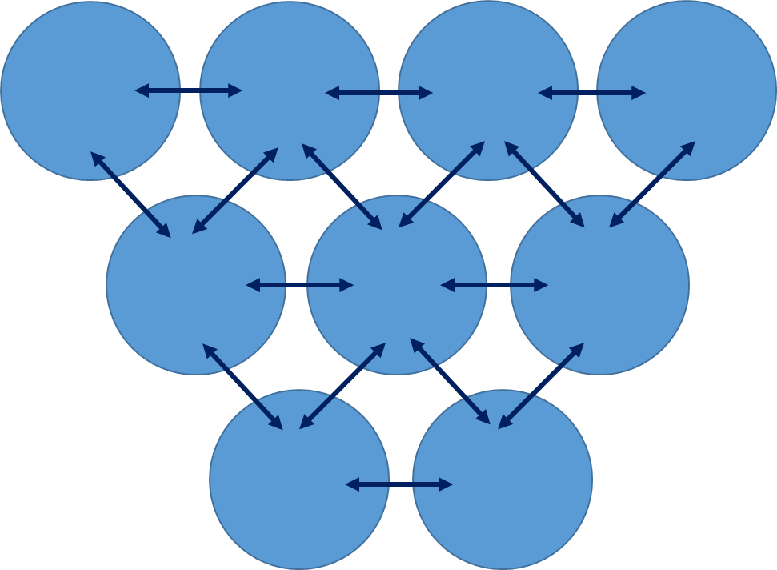
Object
Procedural
Do this
Do this next
And then do this
And so on
And the next line
Top to bottom
Object Oriented

Slide 136
Object
Static methods

Slide 137
JASON
"firstName":"John"
{"firstName":"John", "lastName":"Doe"}
JSON.parse(text)
JSON.stringify(obj)
"employees":[
{"firstName":"John", "lastName":"Doe"},
{"firstName":"Anna", "lastName":"Smith"},
{"firstName":"Peter", "lastName":"Jones"}
]

Slide 138

Cookies
Cookies are data, stored in small text files, on your computer.

Slide 139



REFERENCES

Slide 140
Questions ???

